Slide 1
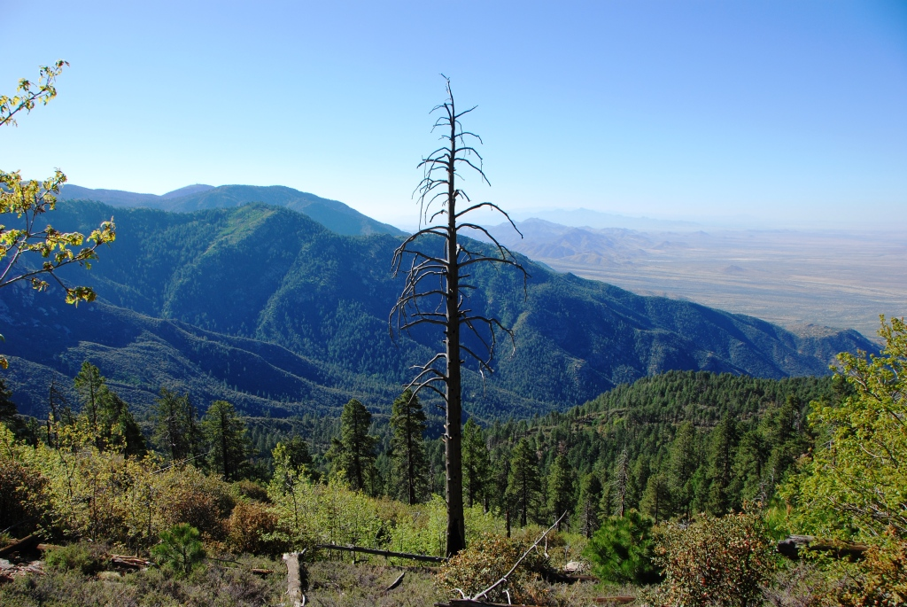
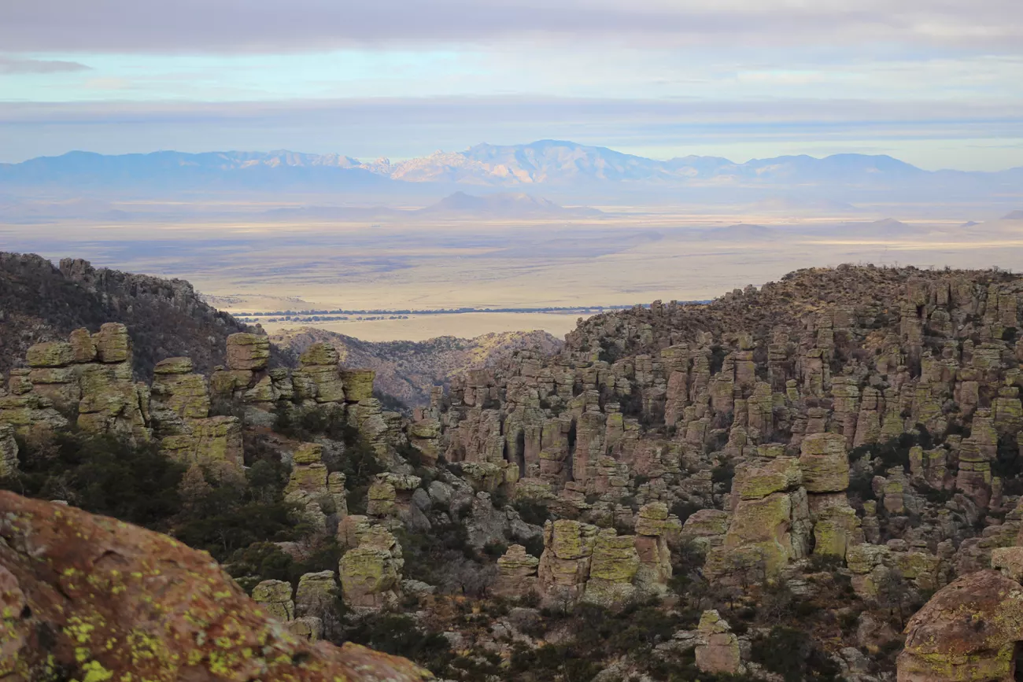
Temporal and Habitat Change Analysis of Arizona Sky Islands
Eric Gibson

Slide 2
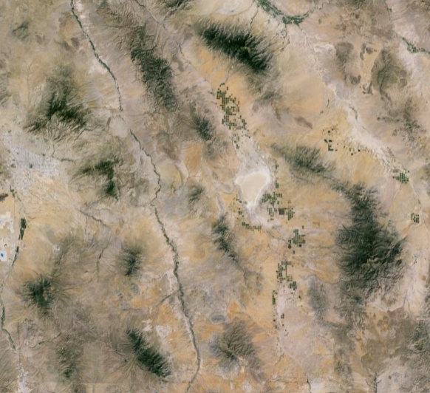
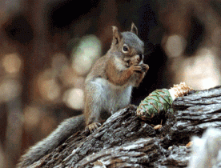
Introduction
Sky islands are created when air masses collide with mountain ranges, rise, cool, condense, and precipitate, allowing for more biodiversity at the higher elevations, while lower elevations tend to be much drier
This creates “islands” of wildlife which cannot traverse the harsh landscapes at lower elevations
Sky islands harbor endemic species through millions of years of evolutionary changes, making them natural laboratories for studying species interactions and evolution
Southeastern Arizona, United States
Source: earth.google.com
Source: https://mgio.arizona.edu/mount-graham- red-squirrel

Slide 3
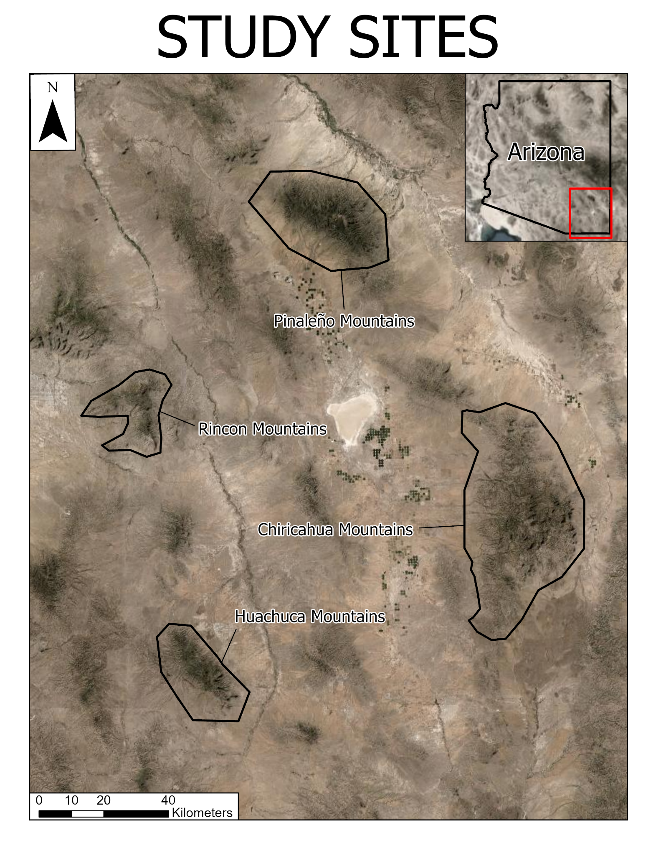
Introduction cont.
Climate change has a large impact on sky islands due to their fragility
Recent effects of climate change including desertification and wildfires, due to the prolonged warm, dry summers of the region, have threatened these endemic species
This project seeks to determine the overall changes of four separate sky islands over ten years to predict future shifts and variations in habitats

Slide 4
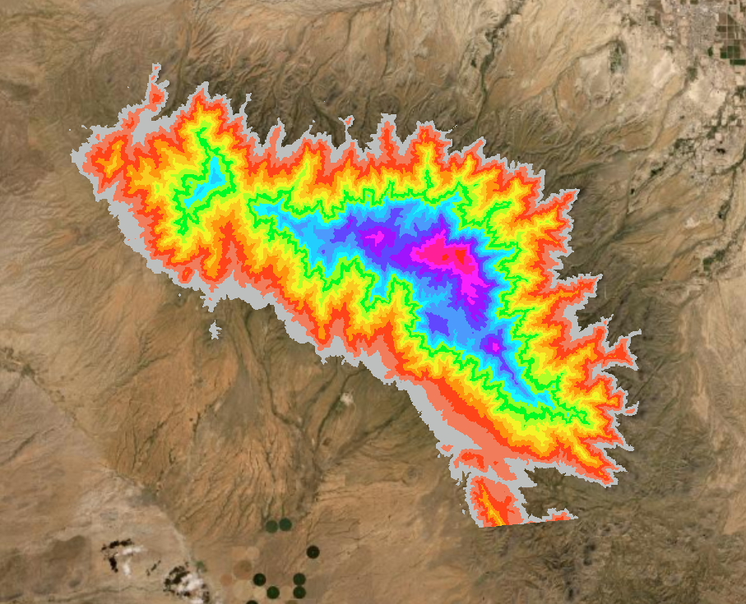
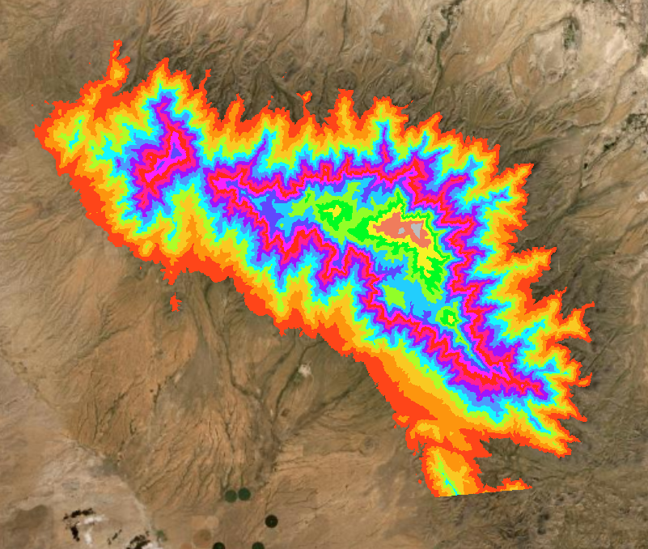
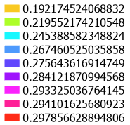
Methods - Elevation Analysis
Landsat 8 imagery was gathered via USGS’s Earth Explorer
Band 4 (Red) and Band 5 (NIR)
A 30-meter spatial resolution digital elevation model (DEM) from AzGeo was used to find the elevation ranges
Normalized difference vegetation index (NDVI) was calculated to determine the amount and density of vegetation
Equation: (NIR - Red) / (NIR + Red)
A zonal analysis was performed on zones of 100-meter elevation increments using Jupyter Notebooks and ESRI’s Python library, arcpy.
Elevation zones of the Pinaleño Range
Average NDVI values at each elevation zone

Slide 5
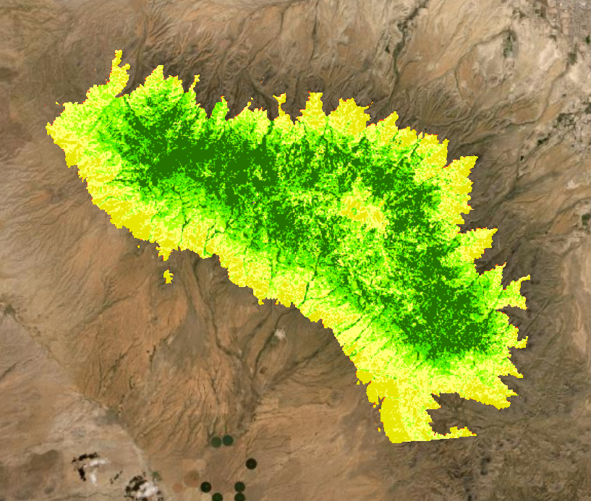
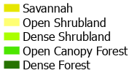
Methods - Habitat Analysis
NDVI * RGB raster value | Habitat Classification
<0 | Water
0 to 4.0x10⁻⁶ | Savannah
4.0x10⁻⁶ to 6.0x10⁻⁶ | Open Shrubland
6.0x10⁻⁶ to 8.0x10⁻⁶ | Dense Shrubland
8.0x10⁻⁶ to 1.0x10⁻⁵ | Open Canopy Forest
1.0x10⁻⁵ to 3.0x10⁻⁵ | Dense Forest
Using an NDVI classification from “Investigative Spatial Distribution and Modelling of Existing and Future Urban Land Changes and Its Impact on Urbanization and Economy” (Akbar, et al.) as well as RGB reflectance, a classification of habitats was created
Band 2 (Blue), Band 3 (Green), Band 4 (Red), and Band 5 (NIR)
Equation: NDVI * (1 / (blue + green + red))
The areas of each habitat were calculated for each year and graphed
Habitat classifications.
Pinaleño Range habitats.

Slide 6
Methods - Habitat Analysis
Accuracy assessment was performed by comparing the created habitat model raster data to Sentinel-2 data (ground-truth)
 | Pinaleño | Rincon
2020 | 61.84834123 | 72.57142857
2021 | 71.56398104 | 59.42857143
2022 | 68.2464455 | 72.57142857
2023 | 67.2985782 | 72.72727273
Average | 67.23933649 | 69.32467532

Slide 7
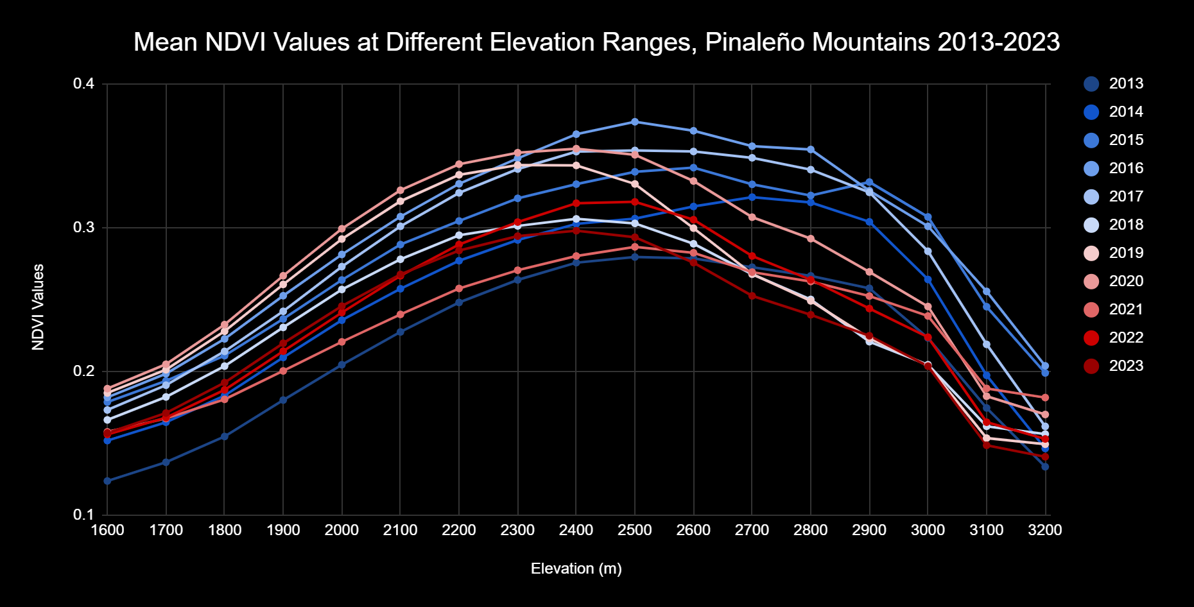
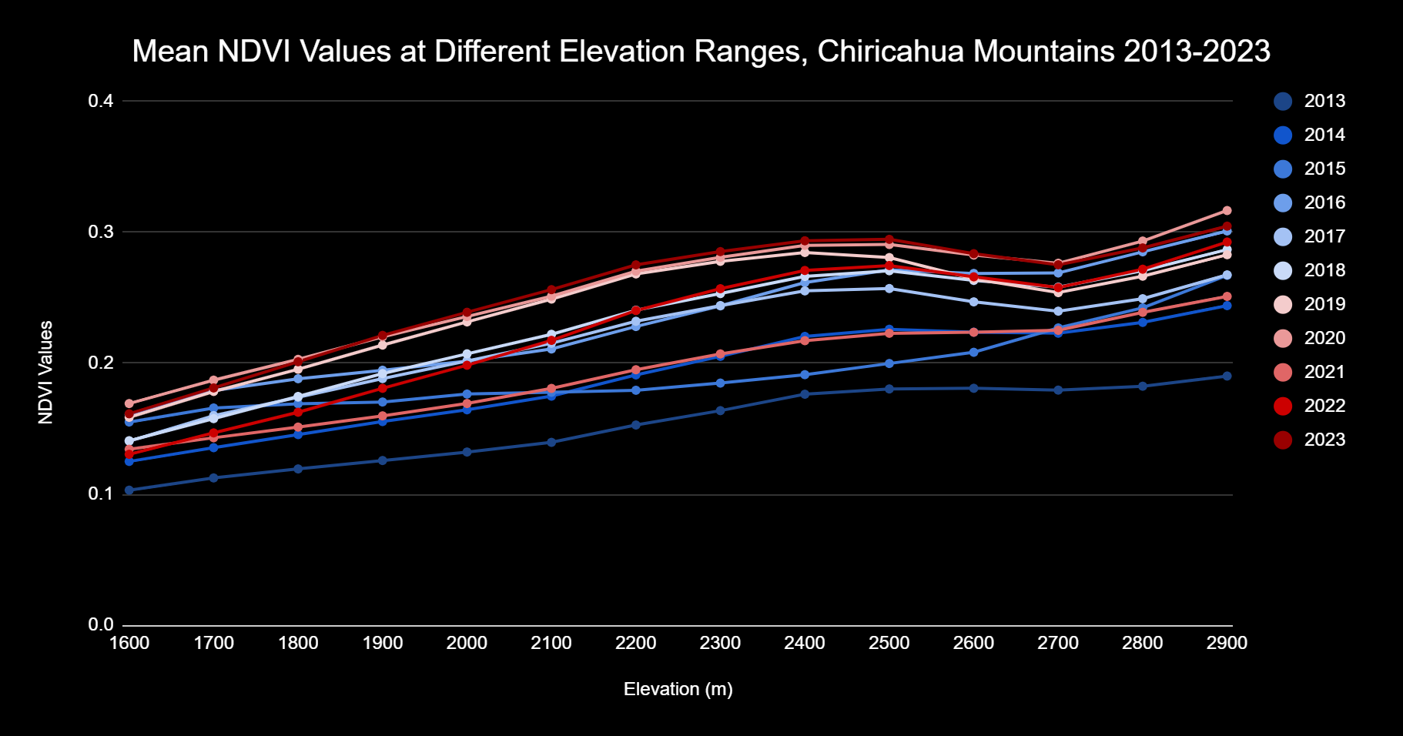
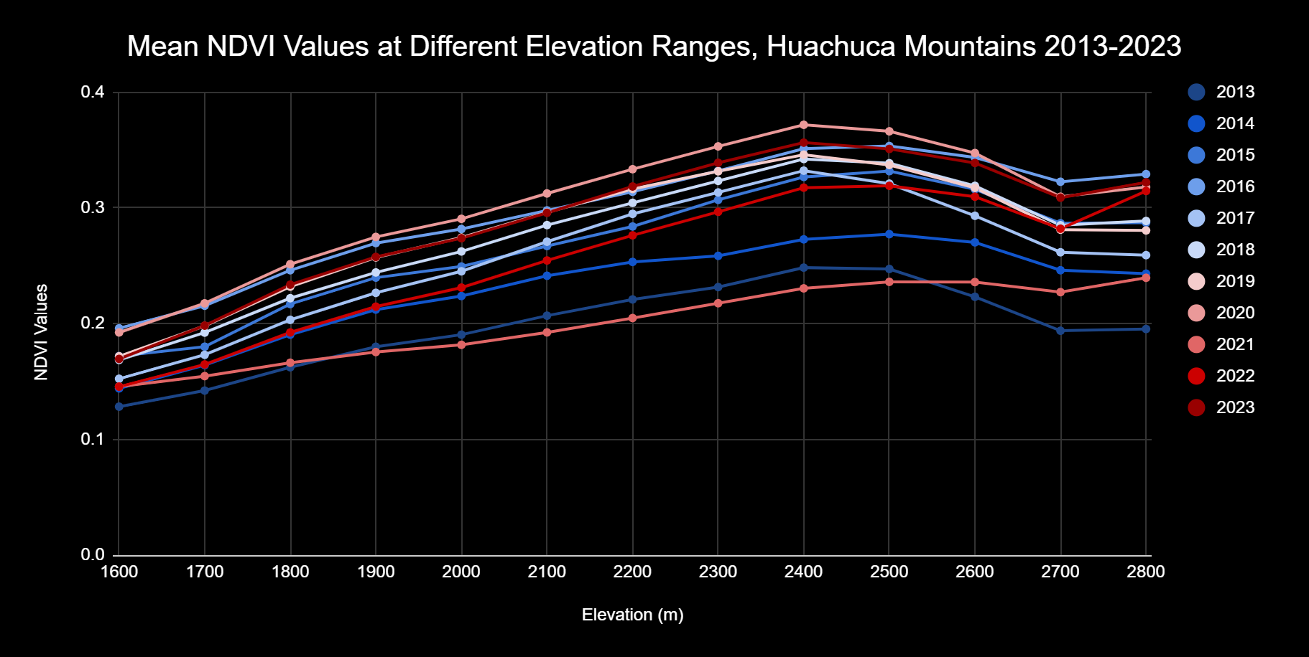
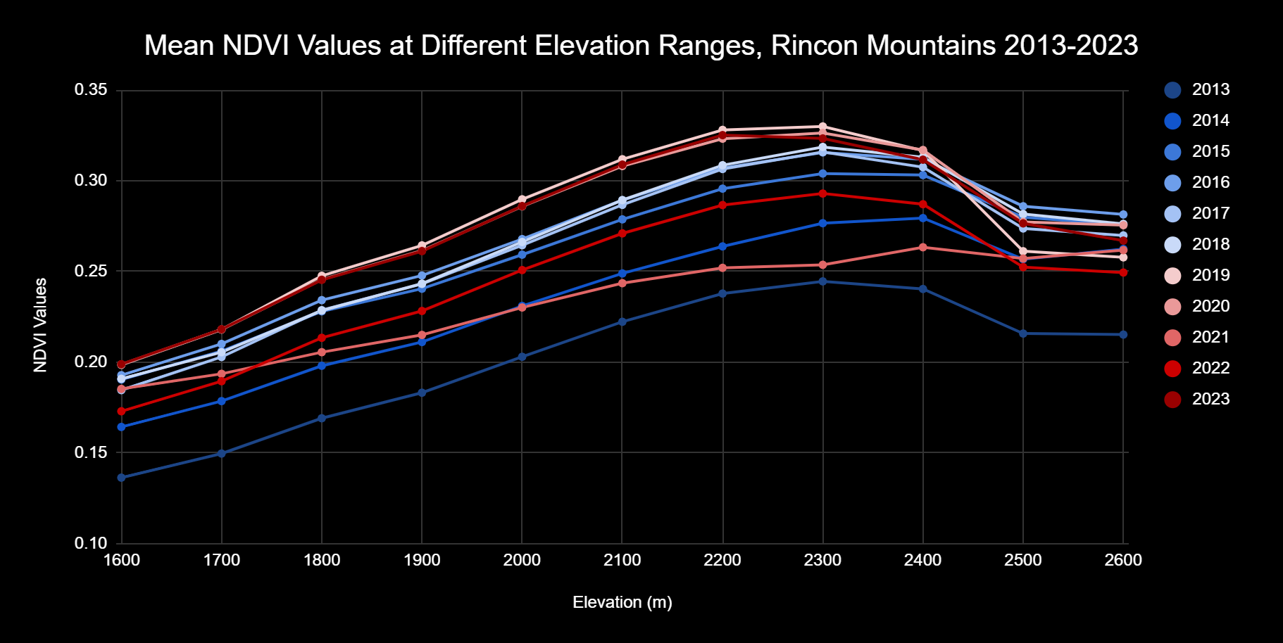
Results - Elevation Analysis

Slide 8
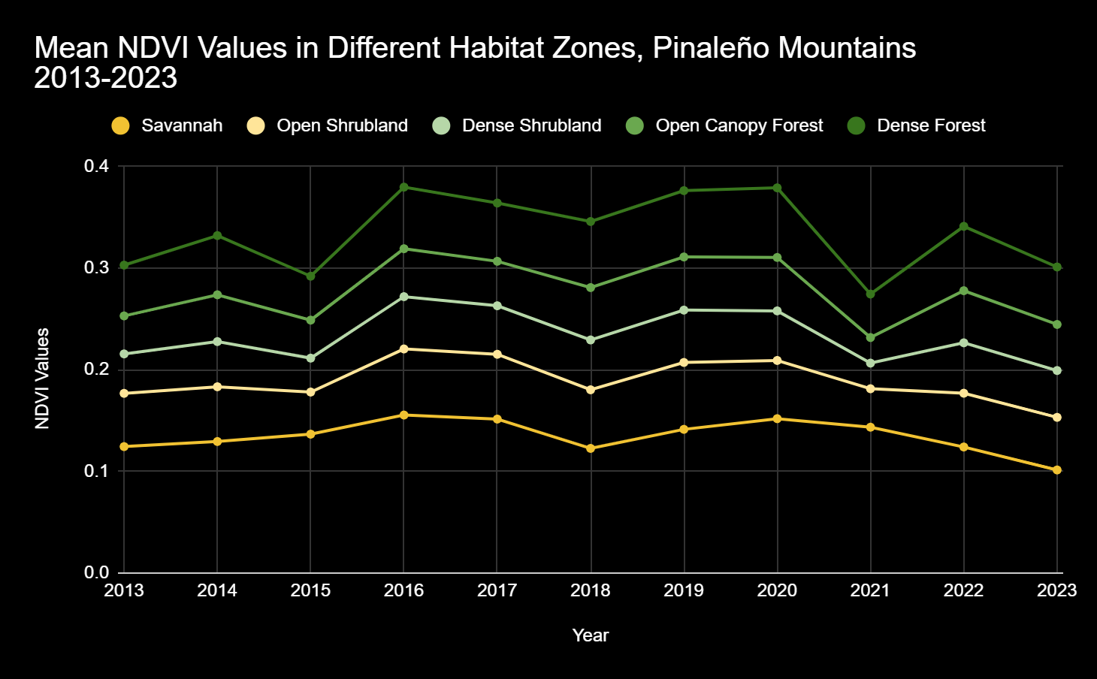
Results - Habitat NDVI, Pinaleño Mountains

Slide 9
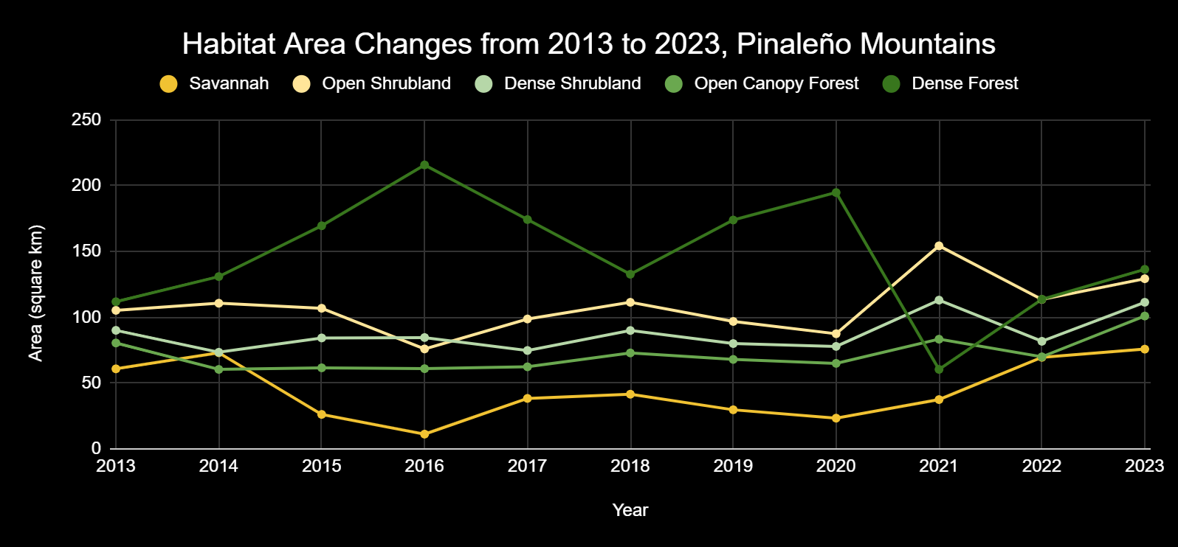
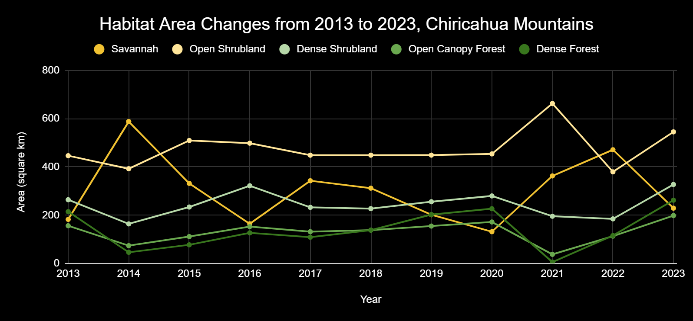
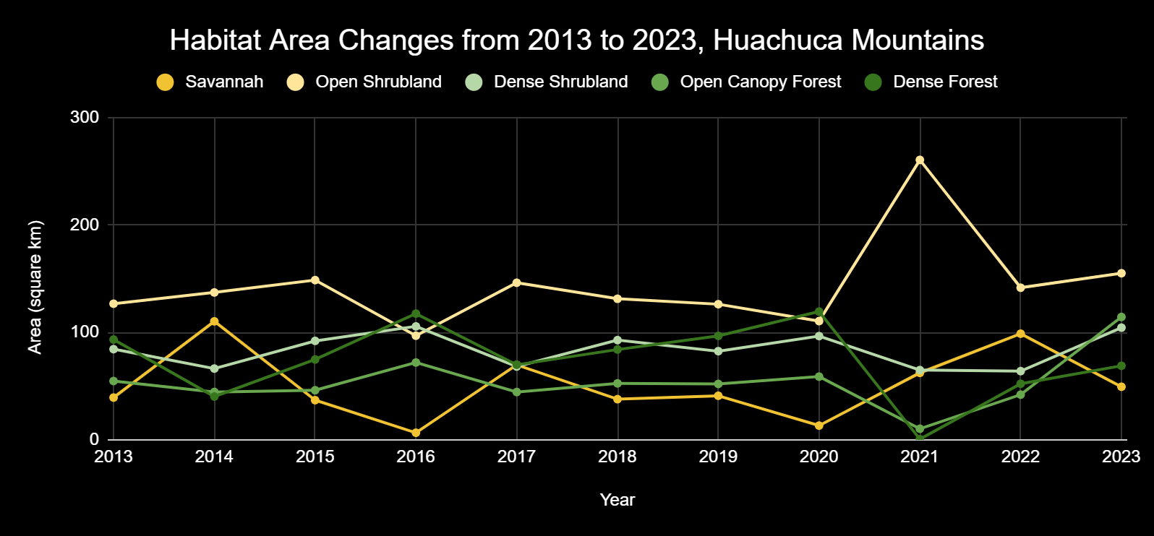
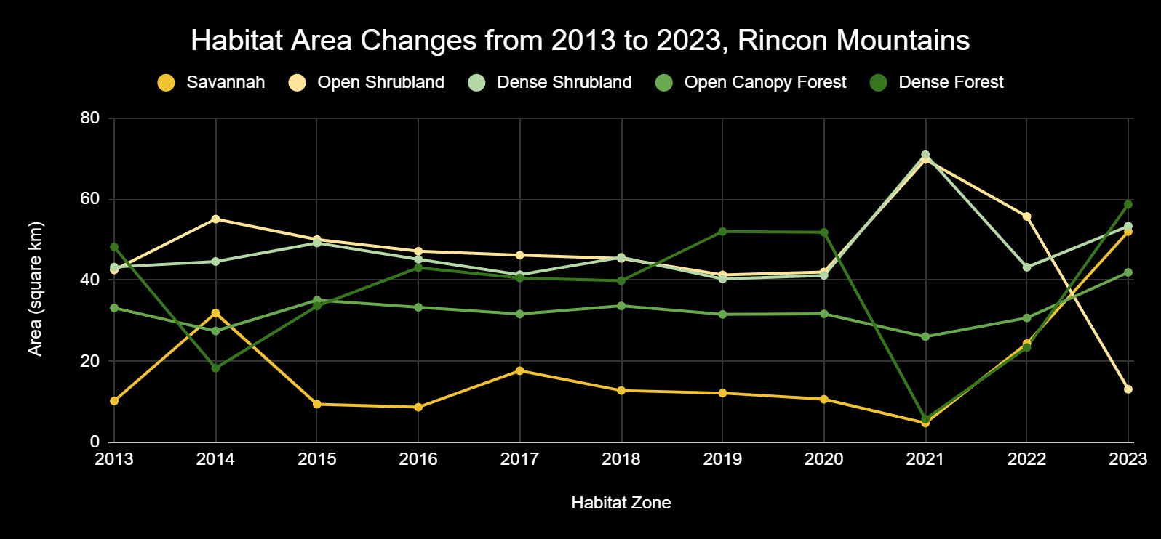
Results - Habitat area

Slide 10
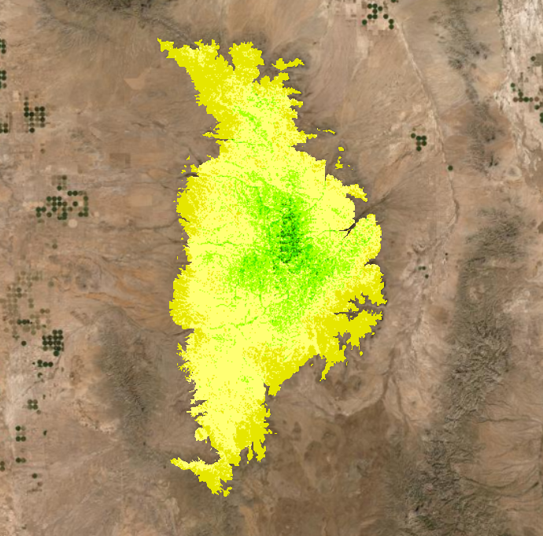
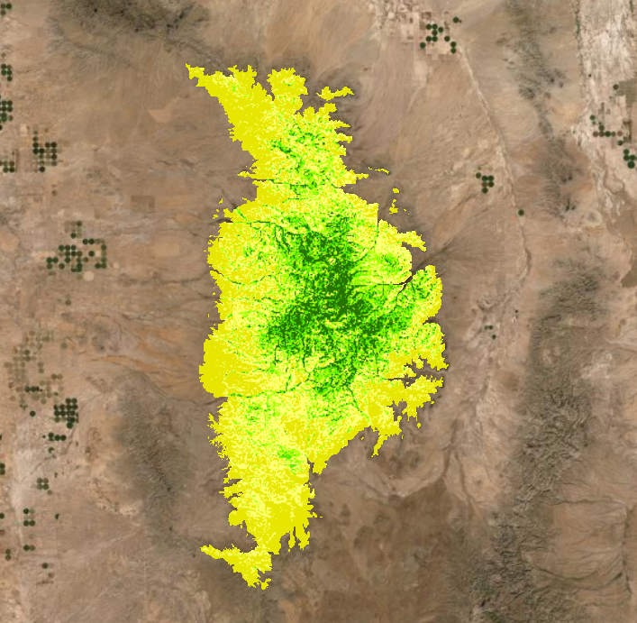
Discussion/Conclusion
The highest elevations tend to have a lower average NDVI values than high-mid elevations
Still, there is not a large net negative change in NDVI values at different elevation ranges throughout the 2013 - 2023 temporal range
Changes in habitat size also do not have a significant net change over the 11 years, however, certain years, like 2018, do show a negative change in dense forest habitat size (likely due to wildfire)
Chiricahua habitats 2021
Chiricahua habitats 2022
Notes:
Another thing to mention is that the habitats with the highest amount of vegetation seem to be the most susceptible to changes in the environment

Slide 11
Improvements/Continuations
Collect data from a greater temporal range, as 11 years may not have been enough to visualize consistent changes
Use more rasters from the same year to have a larger sample size
Use a more definitive habitat classification
Use drone imagery or an in-person survey to more accurately determine habitat classification and specific plant species
Monitor evolutionary changes of species between sky islands

Slide 12
References
Akbar, Tahir Ali, et al. “Investigative Spatial Distribution and Modelling of Existing and Future Urban Land Changes and Its Impact on Urbanization and Economy.” Remote Sensing, vol. 11, no. 2, Jan. 2019. 105.
earth.google.com
He, Kai and Jiang, Xuelong. “Sky islands of southwest China. I: an overview of phylogeographic patterns.” Chinese Science Bulletin, vol.59, 15 Jan. 2014, pp. 585–597.
IBA. “Pinaleño Mountains Iba - Arizona Important Bird Areas Program.” Arizona Important Bird Areas Program -, 13 Apr. 2016, aziba.org/?page_id=1150. Accessed 22 Apr. 2024.
Koprowski, John. “Conservation Research Laboratorydr. John Koprowski - University of Arizona.” CRL: Mount Graham Red Squirrel Monitoring Program, ag.arizona.edu/research/redsquirrel/ fryefire-main.html. Accessed 11 Apr. 2024.
United States, Congress, Office of Arid Lands Studies, and Steven P McLaughlin. University of Arizona, 1994, pp. 60–70.
NPS. “Sky Islands.” National Parks Service, U.S. Department of the Interior, www.nps.gov/chir/learn/nature/sky-islands.htm. Accessed 22 Apr. 2024.
Pelletier, Jon D, et al. “Coevolution of nonlinear trends in vegetation, soils, and topography with elevation and slope aspect: A case study in the sky islands of southern Arizona.” Journal of Geophysical Research: Earth Surface, vol. 118, no. 2, 22 Feb. 2013, pp. 741–758.
Young, Paul. “Mount Graham Red Squirrel.” Mount Graham Red Squirrel | Mount Graham International Observatory, University of Arizona, mgio.arizona.edu/mount-graham-red-squirrel. Accessed 20 Apr. 2024.

